Slide 1

Toronto AirBnB Pricing Assistant (TAPA)
Group 3: Project 4 Submission – Sean Schallberger, Jitesh Makan, Bryan Carney

Slide 2


Project Overview
The Toronto AirBnB Pricing Assistant (TAPA) is a data-driven tool that helps AirBnB hosts, and property investors optimize their rental pricing strategy in Toronto. By analyzing Inside AirBnB data and identifying key amenity value drivers, this tool provides actionable insights on optimal pricing, amenity recommendations, and stay duration strategy for the Toronto short-term rental market.
This project applies machine learning techniques to recommend optimal pricing, identify high-value amenities, and suggest appropriate stay duration strategies for property owners in Toronto's competitive AirBnB market.
Our tool is designed specifically for:
Current AirBnB hosts looking to optimize pricing and amenities
Potential investors evaluating rental strategies
Property owners considering conversion to AirBnB rentals
Our stakeholders need:
Data-driven price recommendations
Understanding of amenity value impact
Guidance on short-term vs. long-term stay strategy

Slide 3

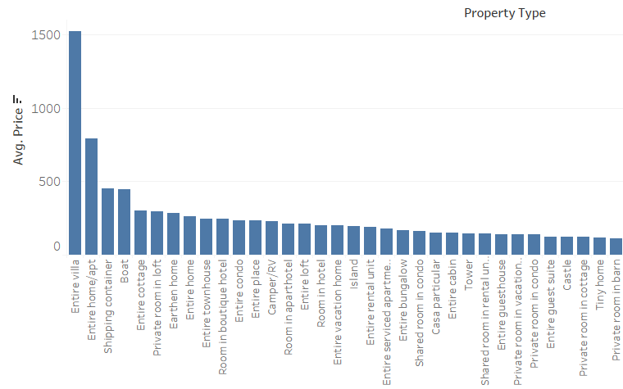
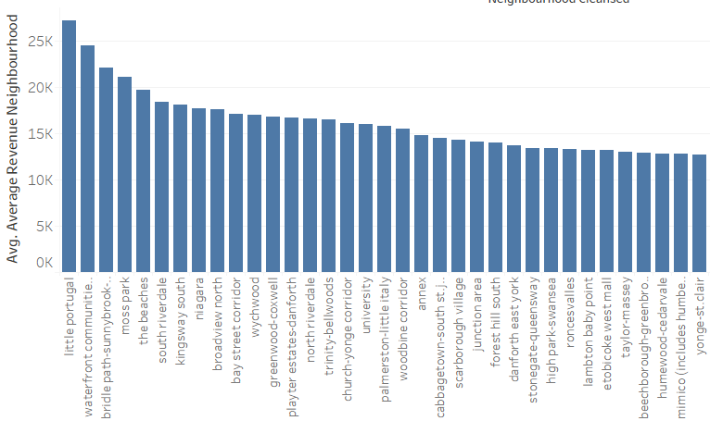
Data & Feature Engineering Transforming Raw Listings into Actionable Insights
Data Source:
Used cleaned .csv file from Airbnb dataset
Initial EDA and Preprocessing:
Dropped high-cardinality or irrelevant columns
Numerical & Categorical Features:
Introduced new features to capture nonlinear relationships:
Boolean and String Binarization
Extracted amenities
Feature Selection:
Removed low-value or redundant columns manually
Based on intuition, correlation checks, and early testing
No PCA or SHAP-based feature dropping used in final model
Selected features from final preprocessed Data Frame
Target Transformation:
Applied log1p() transformation to targets (price, occupancy, revenue)
Improves model performance by reducing skew and stabilizing variance
Train/Test Split:
80/20 split for each model
random_state=42 used for reproducibility

Slide 4

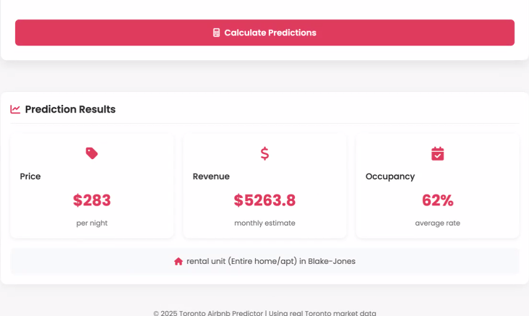
Machine Learning Models XGBoost-Powered Models Tuned for Airbnb Insights
Modeling Targets:
Train separate XGBoost Regressors for each target:
price
occupancy_rate
monthly_revenue
XGBoost Configuration:
Used XGBRegressor() with tuned
hyperparameters for each model
Focus on Key tuned parameters
Evaluation Metrics:
R² Score – Percentage of variance explained
RMSE – Average prediction error (in original scale)
Key Observations
Price model consistently showed highest predictive strength
Log-transformed targets played a major role in model stability
Feature engineering significantly boosted model accuracy

Slide 5




Web App & Deployment Bringing TAPA and its insights to your fingertips
Coding the ML into the Browser
JavaScript front-end form for user input
Model files exported to JSON and hosted on AWS S3
Client-side fetch and prediction logic for real-time UX
Deployed on GitHub Pages for public access

Slide 6

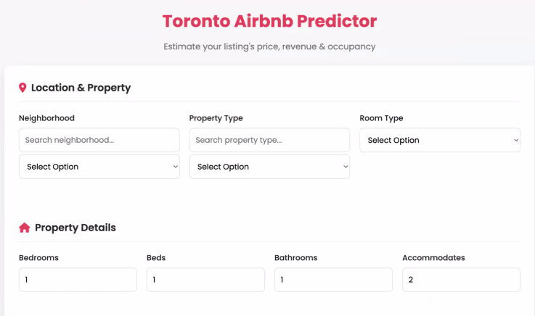
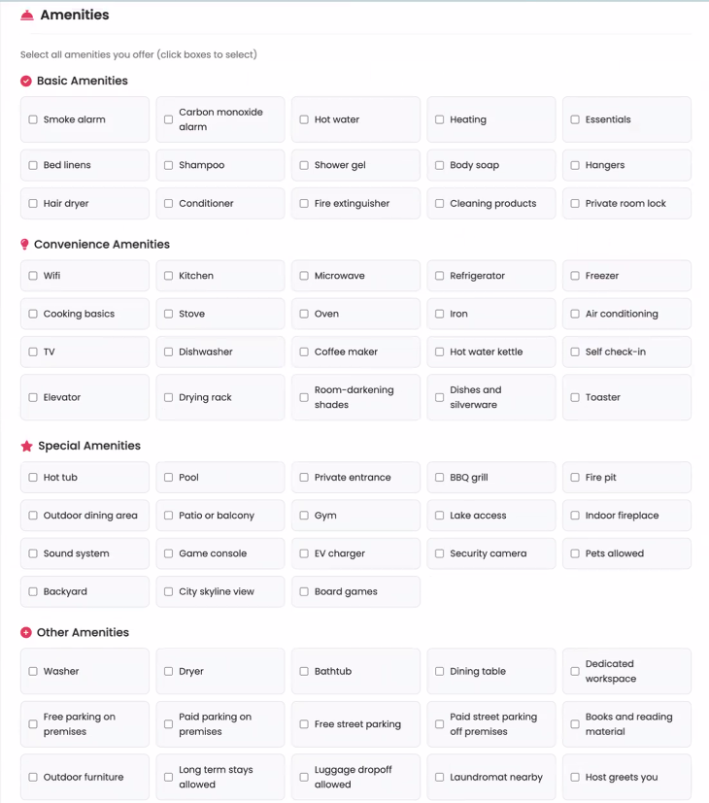
Thank you / Q&A
Thanks for Exploring the Future of Airbnb Pricing!
Link: Toronto Airbnb Predictor

